Slide 1

NetrAI Your Own Personal Assistant
Environment for Visually impaired people to decrease dependency on other people
Notes:
1

Slide 2
Kaze_Kage PowerPoint
A presentation on NetrAI
OCT 19-20th, 2019

Slide 3

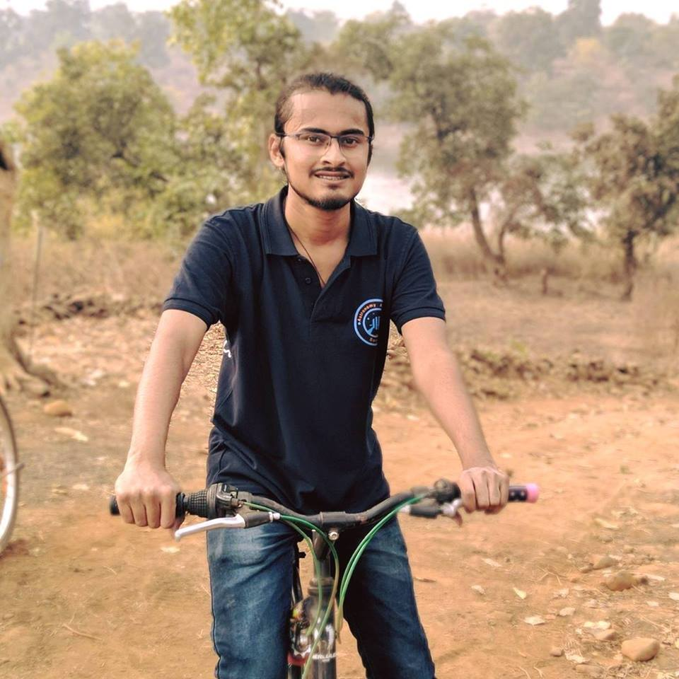
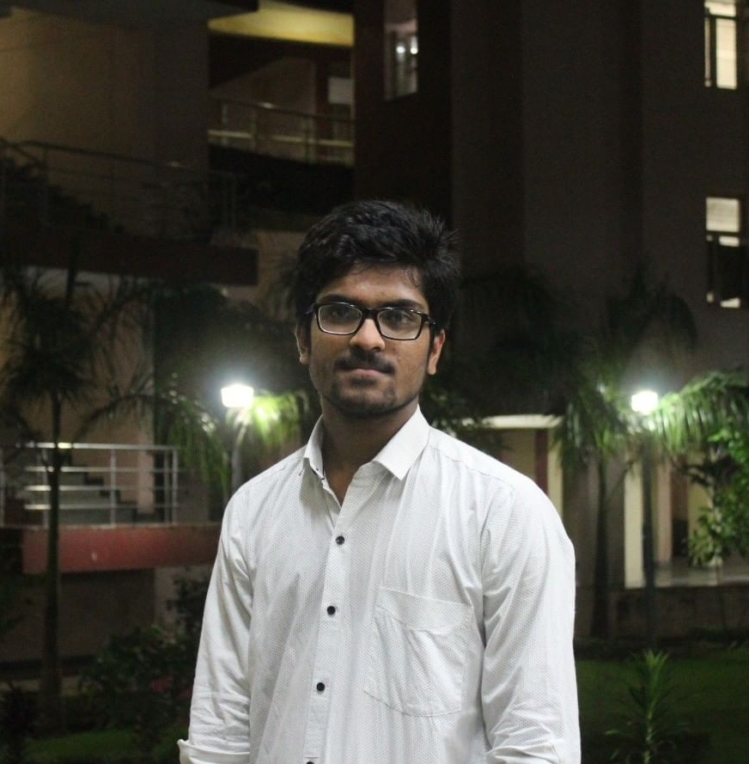
Team Name
Theme
NetrAI
Computer Vision, AI
Abhishek Dhariwal
Divyanshu
Aman Singhal
GitHub: @AbhiDhariwal
GitHub: @Boltuzamaki
GitHub: @aman28singhal
3
Notes:
3

Slide 4
The Problem
4
Notes:
4

Slide 5
135,000,000
No. of Visually Impaired People
Dependent on other people for small daily tasks

Slide 6
IDEA
NetrAI
Following are the problems faced by visually impaired people:
Finding Reading Materials
Identify the thing in hand
Navigating Around the Places
Surfing Internet
To Determine How Much Liquid Is In A Glass

Slide 7
IDEA
NetrAI
We have taken care of a few:
Identifying Objects in the surrounding.
Detect manufacturing and expiry date of consumer products.
Remind them of things they have, that are expired.
Read text from various things.
7
Notes:
In future, it can help local medical stores benefit from the rented rooms by providing medicines and equipment.
It will further help increase employment opportunities for people willing to work as nurses and medicine delivery men for the rented rooms.
7

Slide 8
The Android App.
8
Notes:
In future, it can help local medical stores benefit from the rented rooms by providing medicines and equipment.
It will further help increase employment opportunities for people willing to work as nurses and medicine delivery men for the rented rooms.
8

Slide 9
IDEA
NetrAI
The app is divided into three parts,
The 1st part : Object identification
Captures the image and identifies all the objects using Azure cognitive services.
The 2nd part : Extract mfg. and expiry date.
User clicks the image of the product, and if mfg. date is found, it is read aloud.
If not found, user is prompted to change the orientation and process repeats.
If mfg and expiry date is found user is prompted, if they want to be reminded when the product expires.
The 3rd part : Read text from image
Reads aloud the text that is in the image.
9
Notes:
9

Slide 10
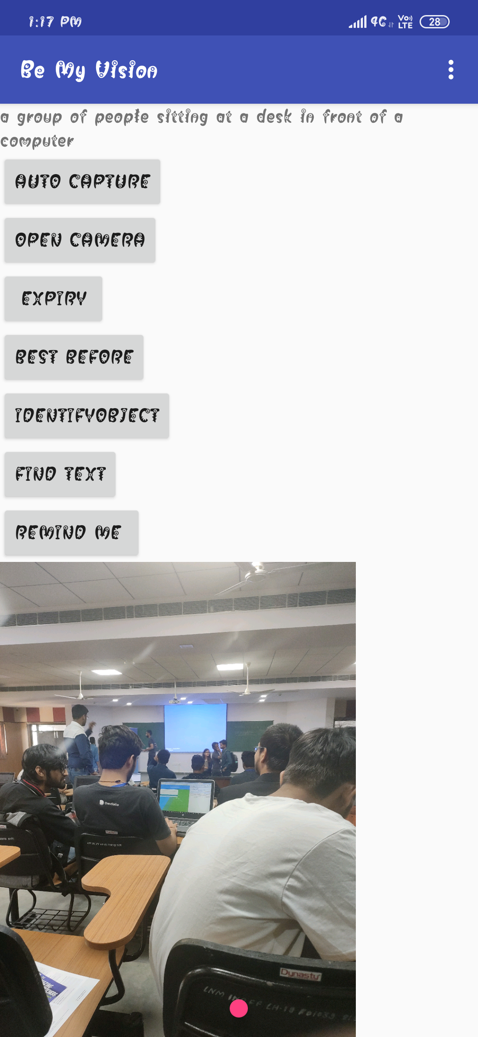
This button captures a photo automatically
The 1st part
Identify objects and surrounding
(Using Azure Cognitive services)
App Interface

Slide 11
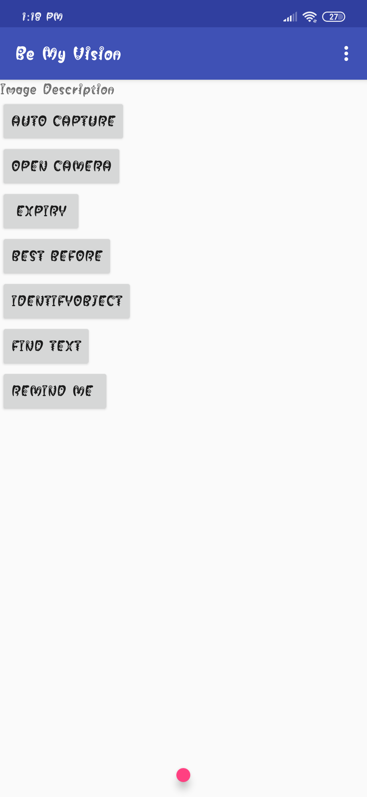
This button captures a photo automatically
Detects mfg. and expiry date
(Date is read aloud)
The 2nd part
Will notify the visually impaired when the item has expired, so that it is not used after expiry date
App Interface

Slide 12
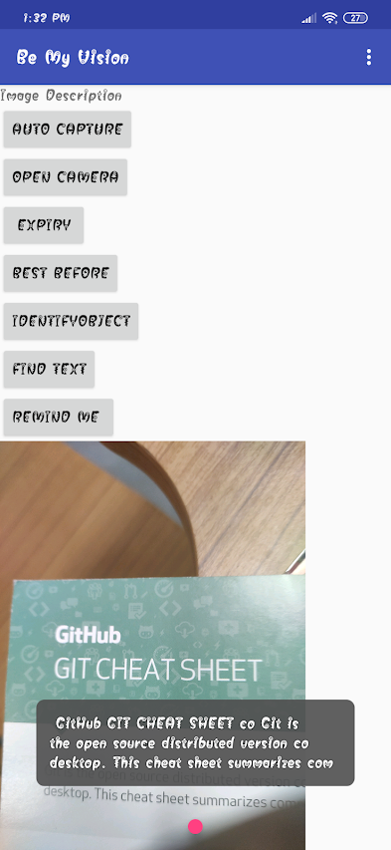
This button captures a photo automatically
The 3rd part
Identify text in the image and reads it aloud
App Interface

Slide 13
The works.
13
Notes:
13

Slide 14
IDEA
NetrAI
Object Identification: Azure Cognitive Services (Cloud)
Text Detection: googles’ ML vision Library (Offline)
Text To Speech: gTTS(Google Text to Speech) (Offline)
14
Notes:
In future, it can help local medical stores benefit from the rented rooms by providing medicines and equipment.
It will further help increase employment opportunities for people willing to work as nurses and medicine delivery men for the rented rooms.
14

Slide 15
IDEA
NetrAI
Roadblocks
Dataset
Expiry dates are printed in different conventions and on different backgrounds. So, expiry identification is very limited for now.
Survey
UI might be a bit challenging for the user because of lack of feedback.
15
Notes:
15

Slide 16
IDEA
NetrAI
PRIVACY
None of the data will be stored on cloud.
All the data will be stored locally.
16
Notes:
16

Slide 17
IDEA
NetrAI
How much will it cost?
Minimal Amount that everyone can afford.
Cloud Services need to be paid.
Continuous bug free updates.
17
Notes:
17

Slide 18
IDEA
NetrAI
Future of the service
Yes, it can scale further.
In future, we would be looking to solve more problems.
Facilitating a visually impaired person to use a ATM can be solved in future.
Detection of doors and stairs can be taken
We can also add ChatBot in the app for better app navigation.
18
Notes:
18

